Slide 1
CORONA VIRUS ANALYSIS
SQL (Structure Query Language)

Slide 2
Content
1. Project Overview 2. Dataset Description 3. Data Exploration and analysis. 4. Analysis (Queries) 5. Summary

Slide 3
Project Overview
The coronavirus pandemic has had a significant impact on public health and has created an urgent need for data-driven insights to understand the spread of the virus.
The coronavirus pandemic has reshaped daily life globally. This analysis of coronavirus data using SQL aims to uncover key insights into its spread and demographic impacts. Join us to explore critical aspects of the pandemic and understand its implications for decision-making and response strategies.
As a data analyst, you have been tasked with analyzing a CORONA VIRUS dataset to derive meaningful insights and present your findings.

Slide 4
Dataset
Description of each column in the dataset:
Province: Geographic subdivision within a country/region.
Country/Region: Geographic entity where data is recorded.
Latitude: North-south position on Earth's surface.
Longitude: East-west position on Earth's surface.
Date: Recorded date of CORONA VIRUS data.
Confirmed: Number of diagnosed CORONA VIRUS cases.
Deaths: Number of CORONA VIRUS-related deaths.
Recovered: Number of recovered CORONA VIRUS cases

Slide 5
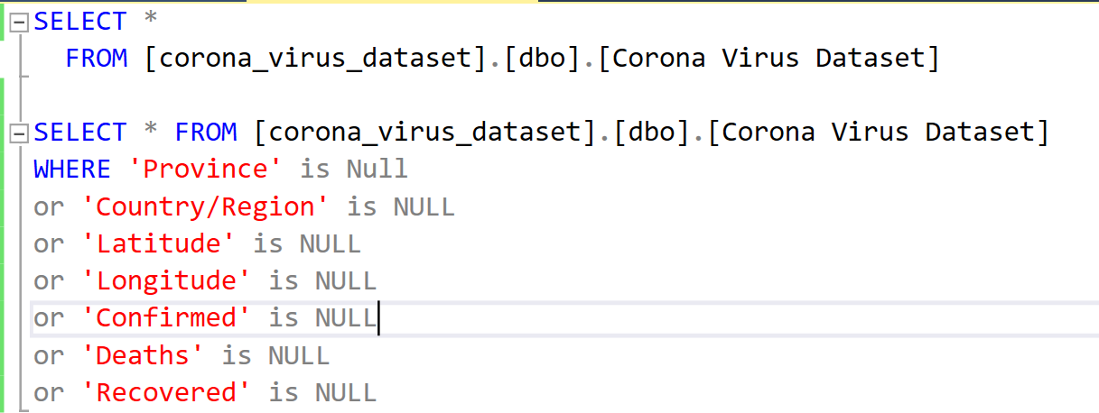


Q1 - Write a code to check NULL values. / Q2- If NULL values are present, update them with zeros for all columns
Data Exploration and analysis-Data Cleaning
Query
Result
Not have any null value present

Slide 6
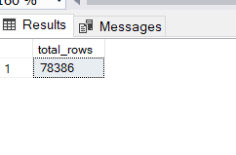
Q3 - Check total number of rows
Query
Result

Slide 7
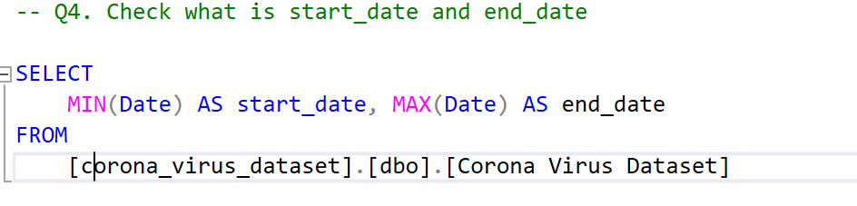
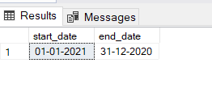
Q4 - Check what is start_date and end_date
Query
Result

Slide 8
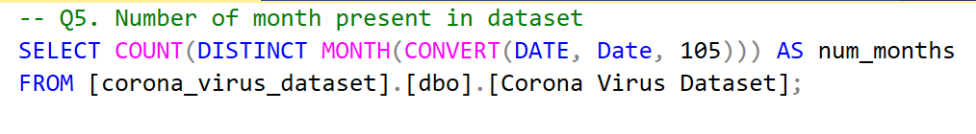

Q5 - Number of months present in dataset
Query
Result

Slide 9
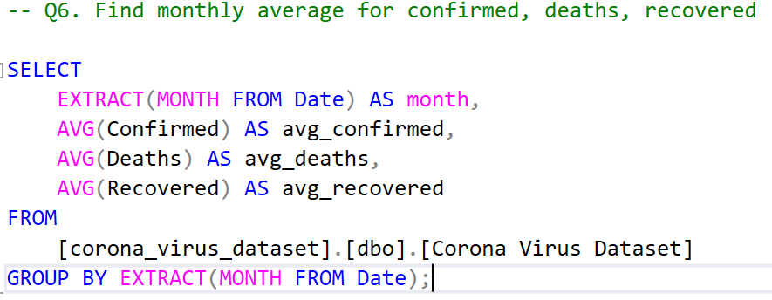
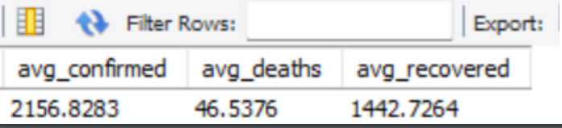
Q6 - Find average for confirmed, deaths, recovered
Query
Result

Slide 10
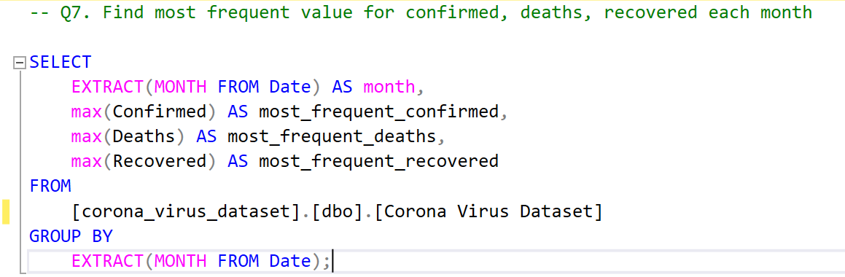
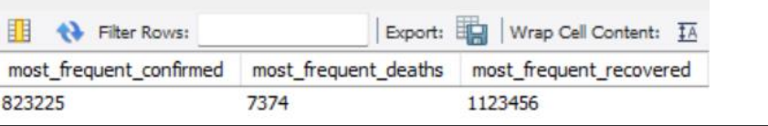
Q7 - Find the most frequent value for confirmed, deaths recovered each month
Query
Result

Slide 11
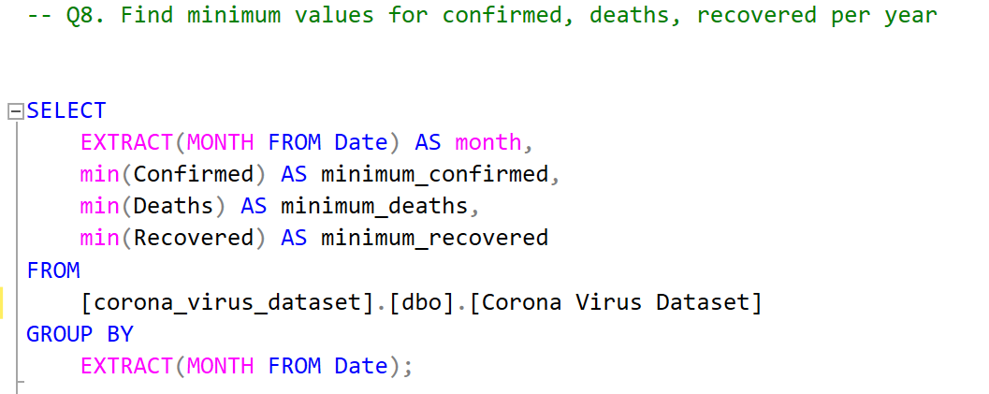
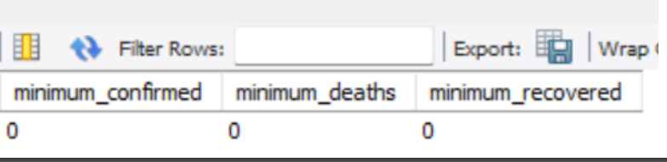
Q8 -Find minimum values for confirmed, deaths, recovered per year
Query
Result

Slide 12
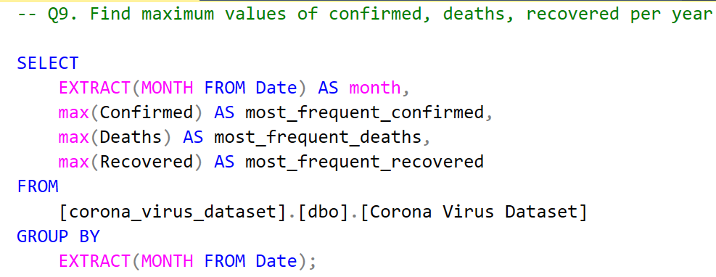
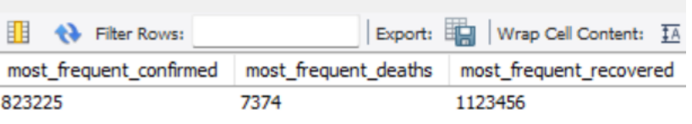
Q9 - Find maximum values of confirmed, deaths recovered per year
Query
Result

Slide 13
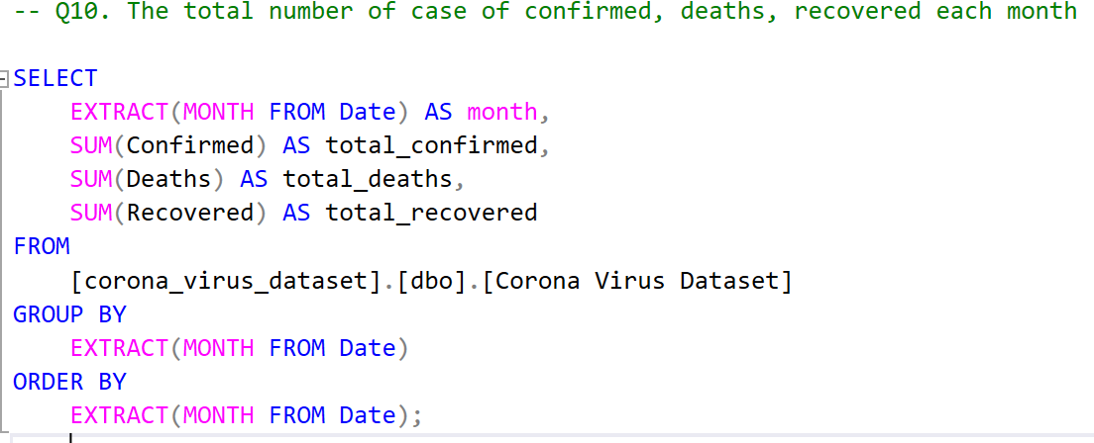
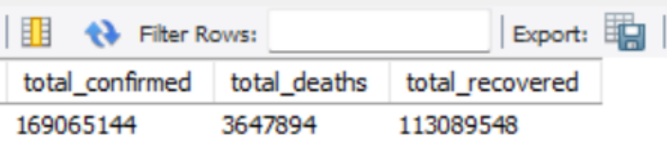
Q10 - The total number of case of confirmed, deaths recovered each month
Query
Result

Slide 14
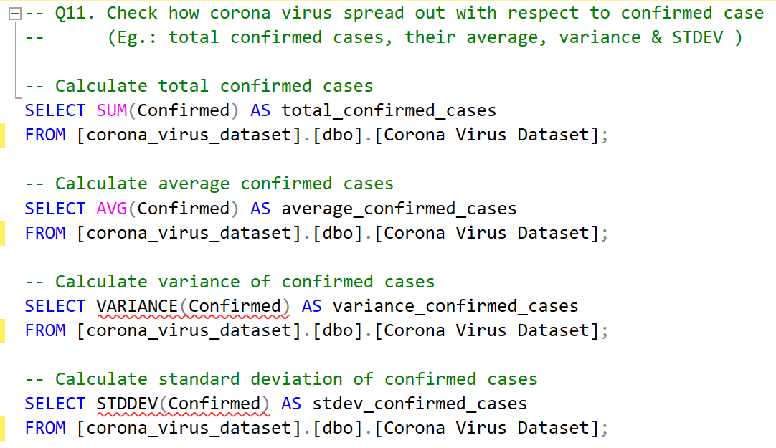
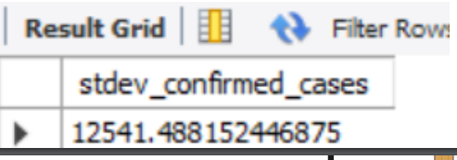
Q11 - Check how corona virus spread out with respect to confirmed case (Eg.: total confirmed cases, their average, variance & STDEV )
Query
Result

Slide 15
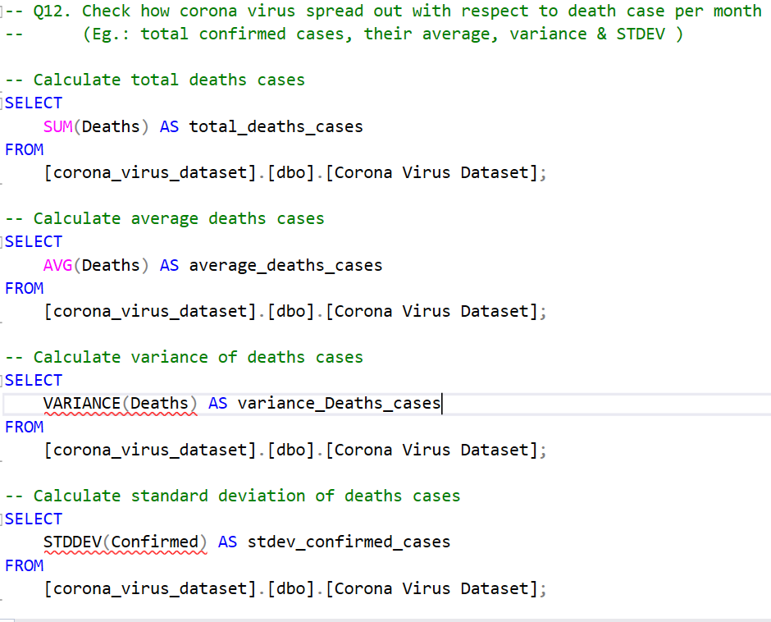
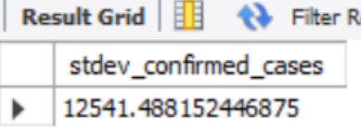
Q12 - Check how coronavirus spread out with respect to death case per month (Eg.: total confirmed cases, their average, variance & STDEV )
Query
Result

Slide 16
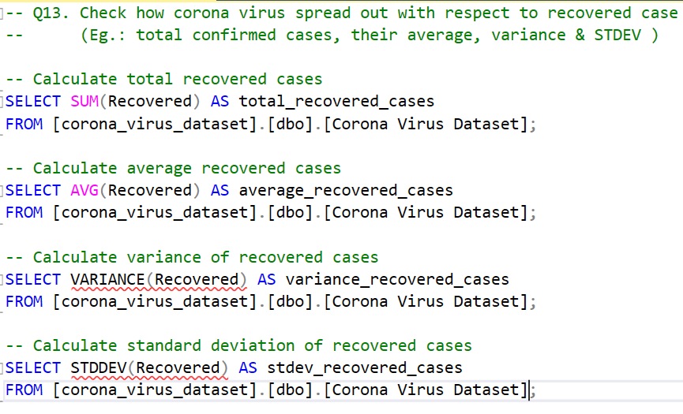
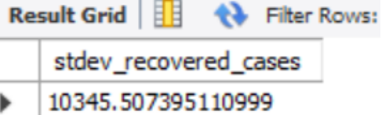
Q13 - Check how coronavirus spread out concerning recovered case (Eg.: total confirmed cases, their average, variance & STDEV )
Query
Result

Slide 17
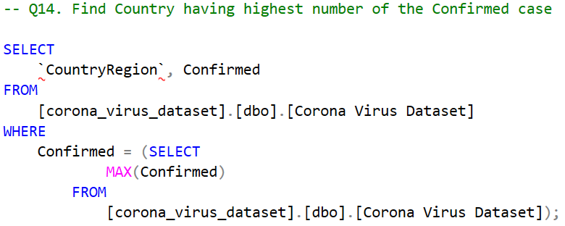
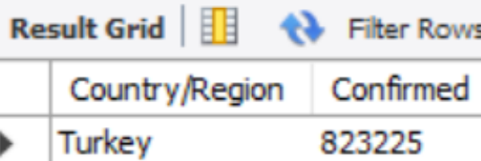
Q14 - Find Country having highest number of the Confirmed case
Query
Result

Slide 18
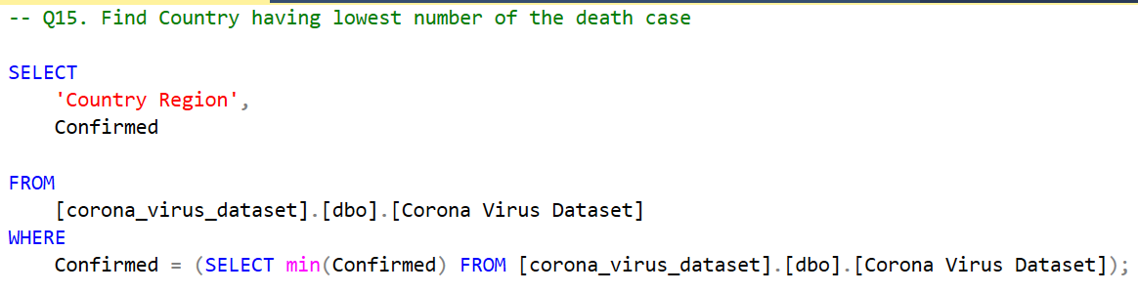
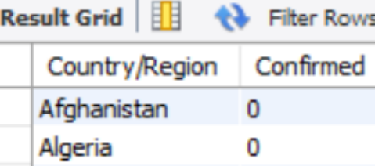
Q15 - Find Country having the lowest number of the death case
Query
Result

Slide 19
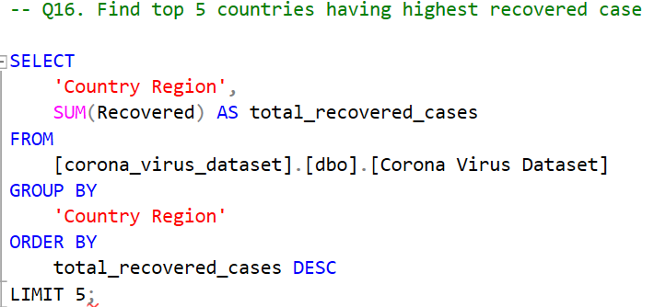
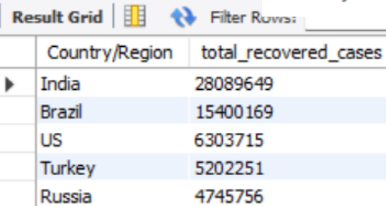
Q16 - Find top 5 countries having highest recovered case
Query
Result

Slide 20
THANKS

